Slide 1
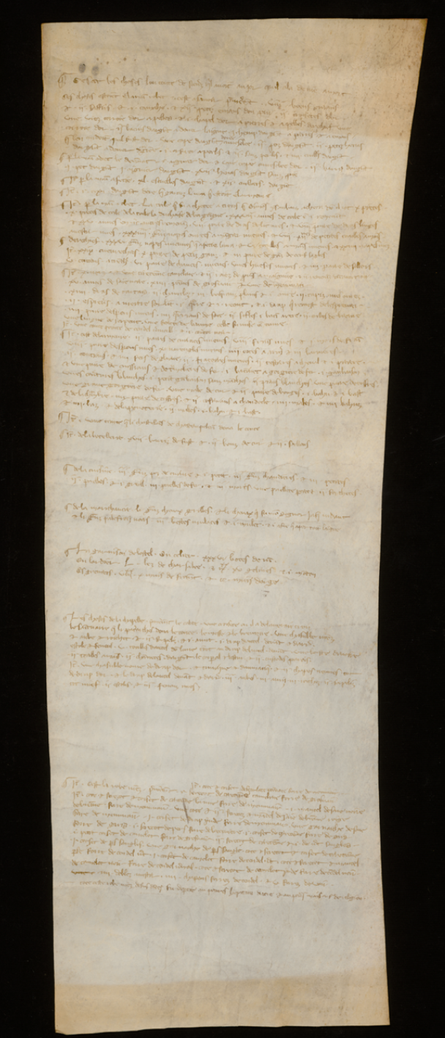
1A recto:
…le henap a pierres que len cuidot quil fust dor • por xxv ￡ • tournois
1A verso:
…por xxv ￡ le henap dargent dore a pierres et a esmaus que len couda quil fust dor
1B recto:
…i henap dargent a pierres et a emaus, que len cuidot quil fust dor • Une cope d’argent ^{doree} cuvesclee • ii petis henas dargent a donner dragiée
….xvii henas dargent sanz pié
1D recto:
…xii enas
…vii henas
…une cope cuvescle dor
….Item por une cope dargent doree a cuvescle
1D verso:
…i henap dargent a pierres que len cuida quil fust dor
....e • i henap dargent a pierres et esmaus
….Une cope dargent cuvesclee
[Transcription Anne Lester & Laura Morreale]
Entries for goblets in the 1266 account inventory of Count Eudes of Nevers
Paris, AN, series J 821/1 Roll B (recto)

Slide 2
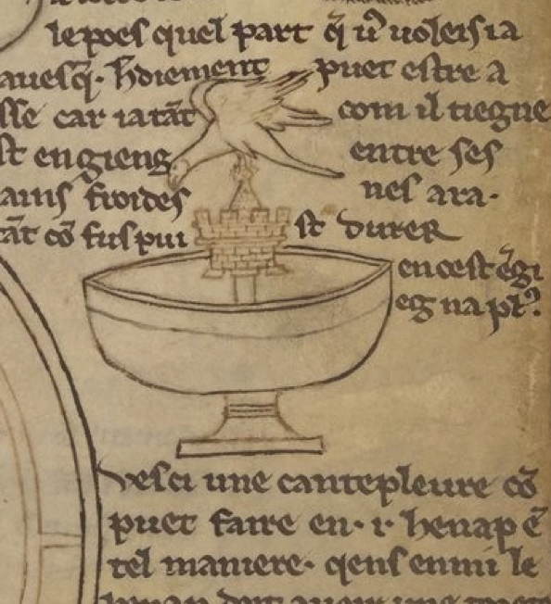
Silver-gilt drinking cup, c. 1300-25
Rouen-Gaillion treasure (disc. 1840)
Paris, musée du Louvre, OA643
Photo © RMN-Grand Palais (musée du Louvre) / Daniel Amaudet
Paris, BNF, Ms. fr. 19093, fol. 9r
c. 1220-1235

Slide 3
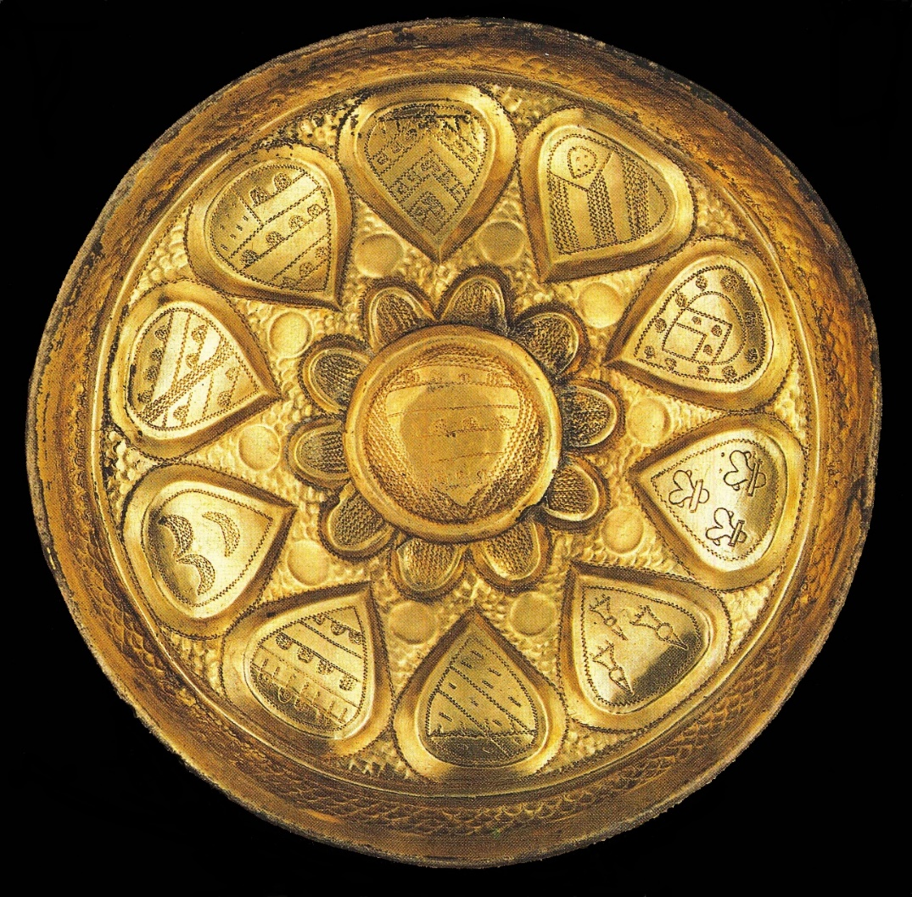
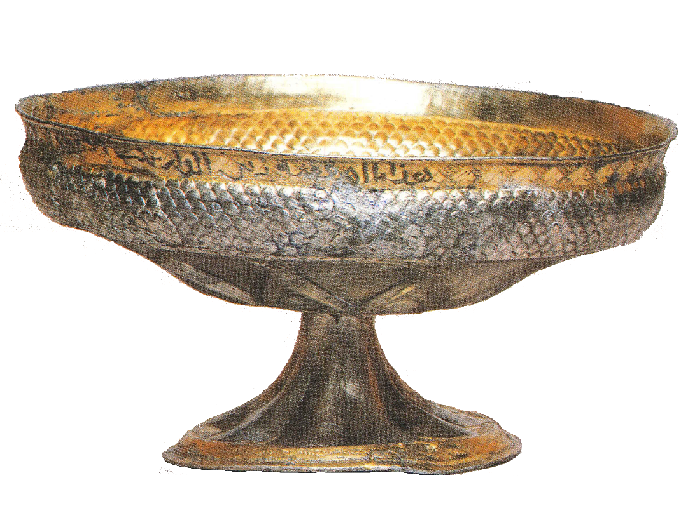
16.5 cm
8.5 cm
Silver-gilt drinking cup, c. 1190–1215
France or England
Repoussé with heraldic engravings
Resafa treasure (disc. 1982)
Damascus, Syria National Museum,
(Inv. Nr. 29313/14)
Photo courtesy of the Deutsches Archäologisches Institut.

Slide 4
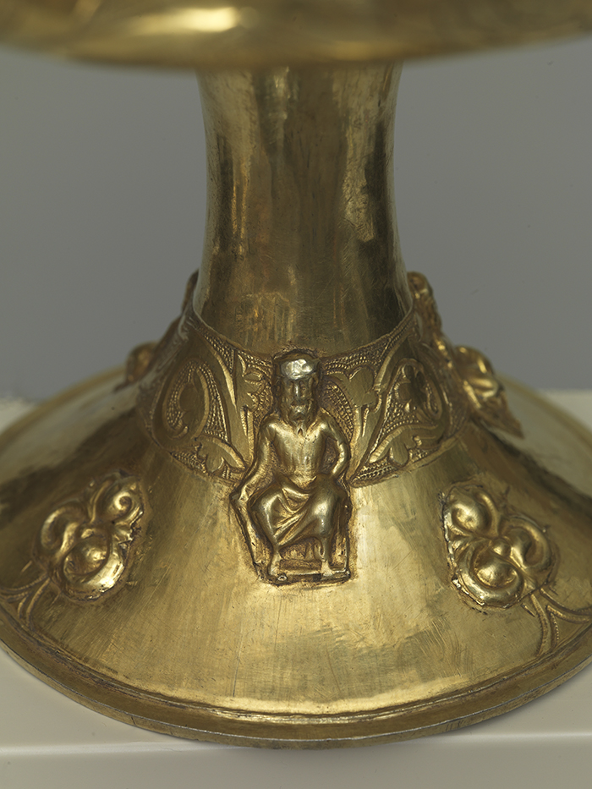
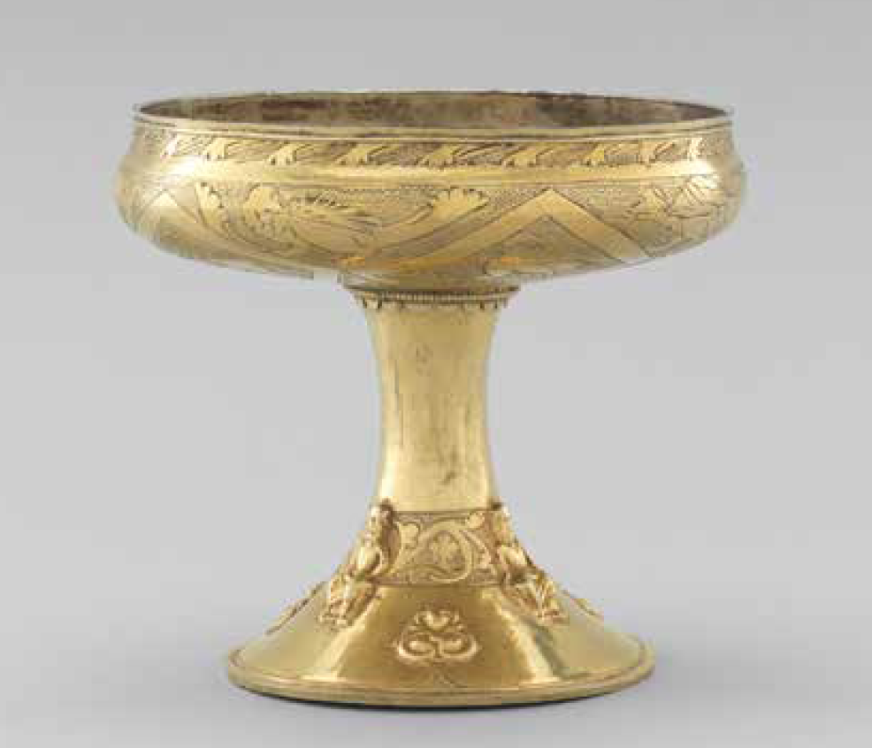
Silver-gilt drinking cup, c. 1200-20
England or Scandinavia
Repoussé with engravings and applique figures
12.7 cm (height) x 14 cm (diameter)
Photos courtesy of Sam Fogg, London

Slide 5
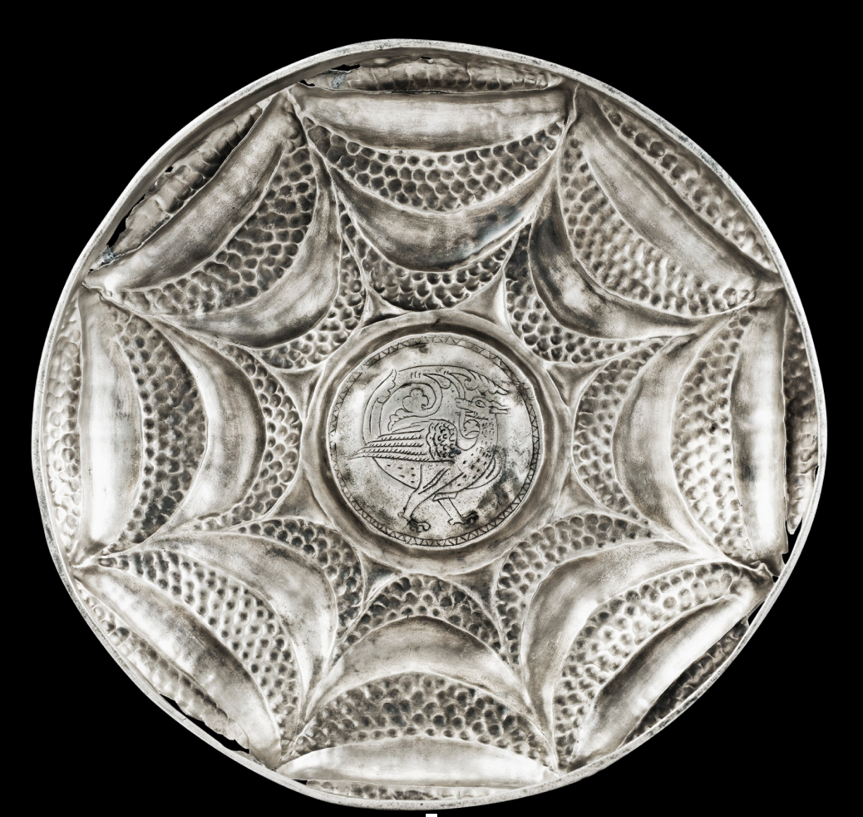
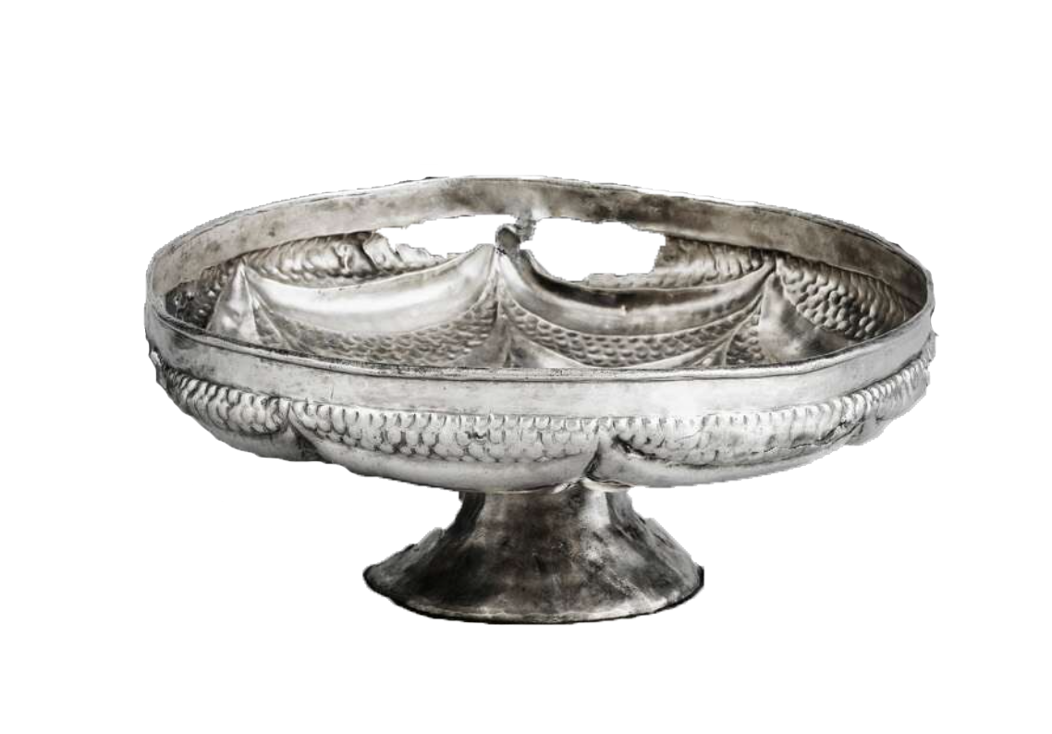
Silver drinking cup, c. 1180
Probably France
Repoussé with engraving
18.6 cm (diameter)
Sotheby’s Paris, 17 May 2011, lot 250

Slide 6
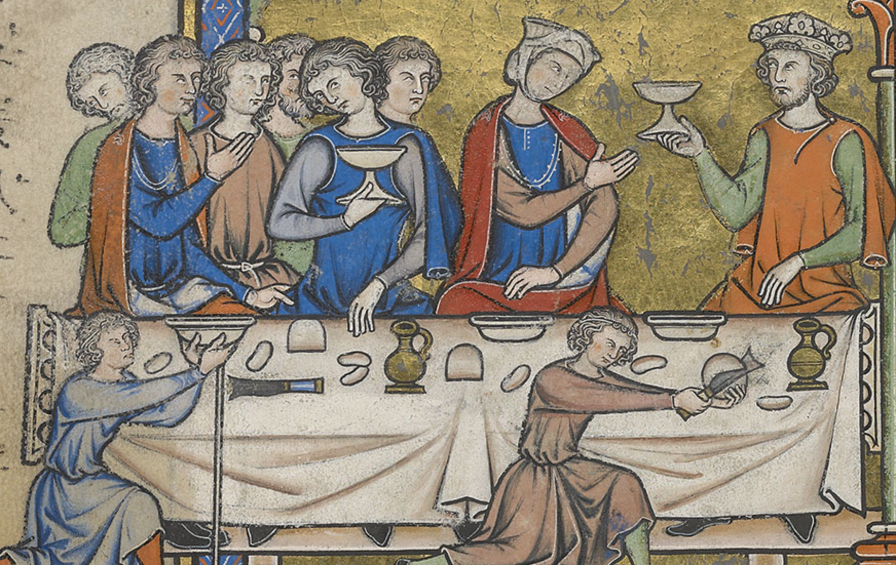
New York, PML, Ms. M. 638, fol. 37r
French, c. 1240-60

Slide 7
1A recto:
…le henap a pierres que len cuidot quil fust dor • por xxv ￡ • tournois
1A verso:
…por xxv ￡ le henap dargent dore a pierres et a esmaus que len couda quil fust dor
1B recto:
…i henap dargent a pierres et a emaus, que len cuidot quil fust dor • Une cope d’argent ^{doree} cuvesclee • ii petis henas dargent a donner dragiée
….xvii henas dargent sanz pié
1D recto:
…xii enas
.…vii henas…une cope cuvescle dor
….Item por une cope dargent doree a cuvescle
1D verso:
…i henap dargent a pierres que len cuida quil fust dor
....e • i henap dargent a pierres et esmaus
….Une cope dargent cuvesclee
[Transcription Anne Lester & Laura Morreale]
Entries for goblets in the 1266 account inventory of Count Eudes of Nevers
Paris, AN, series J 821/1 Roll B (recto)

Slide 8
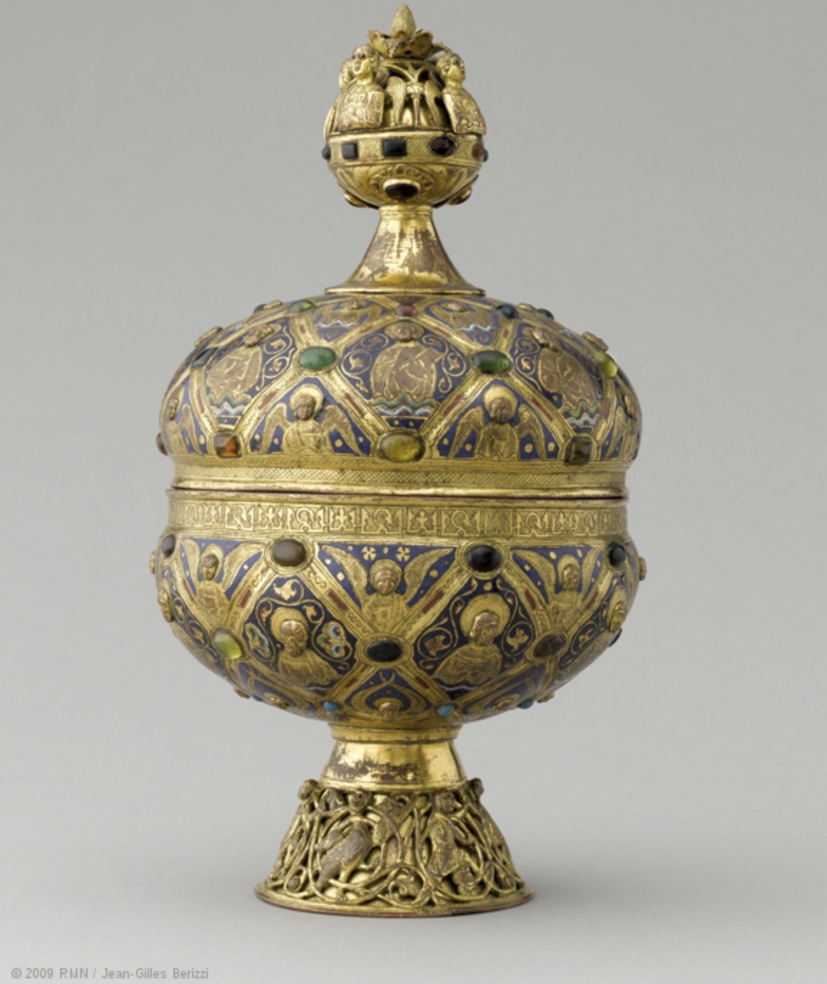
“Maître Alpais ciborium,” c. 1200
Limoges
Copper alloy, gilt, w/
champlevé enamel and glass cabochons
Paris, Louvre
1828 MRR 98

Slide 9
Eudes de Nevers (1230–1266)
m. Maud de Dampierre
Yolande II de Nevers Marguerite, Queen of Sicily (1250–1308) Adelaide, Countess of Auxerre
m. 1) Jean Tristan
m. 2) Robert de Béthune
m. Charles d’Anjou
m. Jean de Chalon
No Issue
Issue:
William de Chalon
Issue from m. 2:
Louis de Nevers
Robert de Cassel
Jeanne de Flandre (c. 1272–1333)
Yolande de Flandre
Mathilde de Flandre
1308 Testament of Marguerite de Bourbon
Lille, AD Nord, B 447, no. 4.621

