Slide 1
Eudes of Nevers’ Account-Inventory
Some Reflections from the East
Jonathan Rubin
Bar Ilan University
Acre, 1918

Slide 2
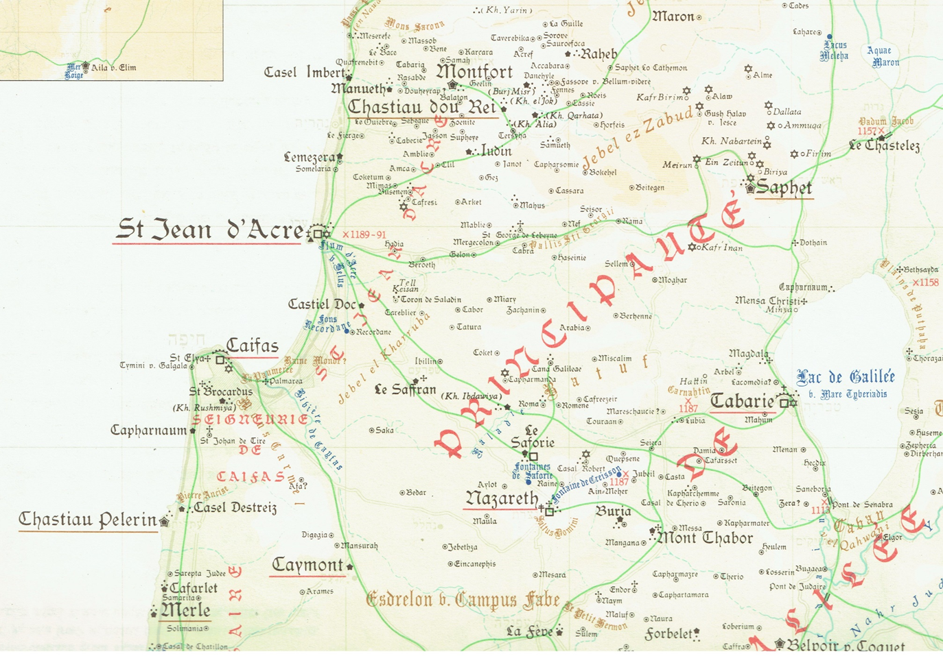
Prawer and Benvenisti, 1972

Slide 3
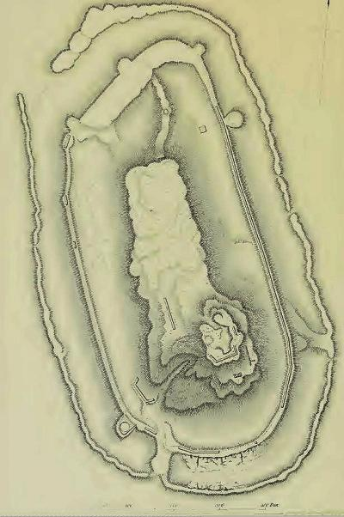
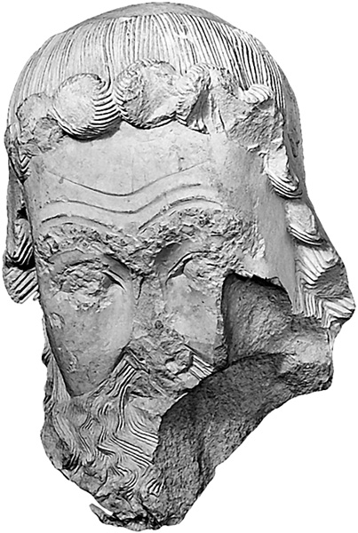
Saphet (Ar. Safad; Heb. Zefat): A Templar Castle Lost to the Mamluks (23.7.1266)
A carved head from Frankish Saphet
Plan: SWP 1.249.

Slide 4
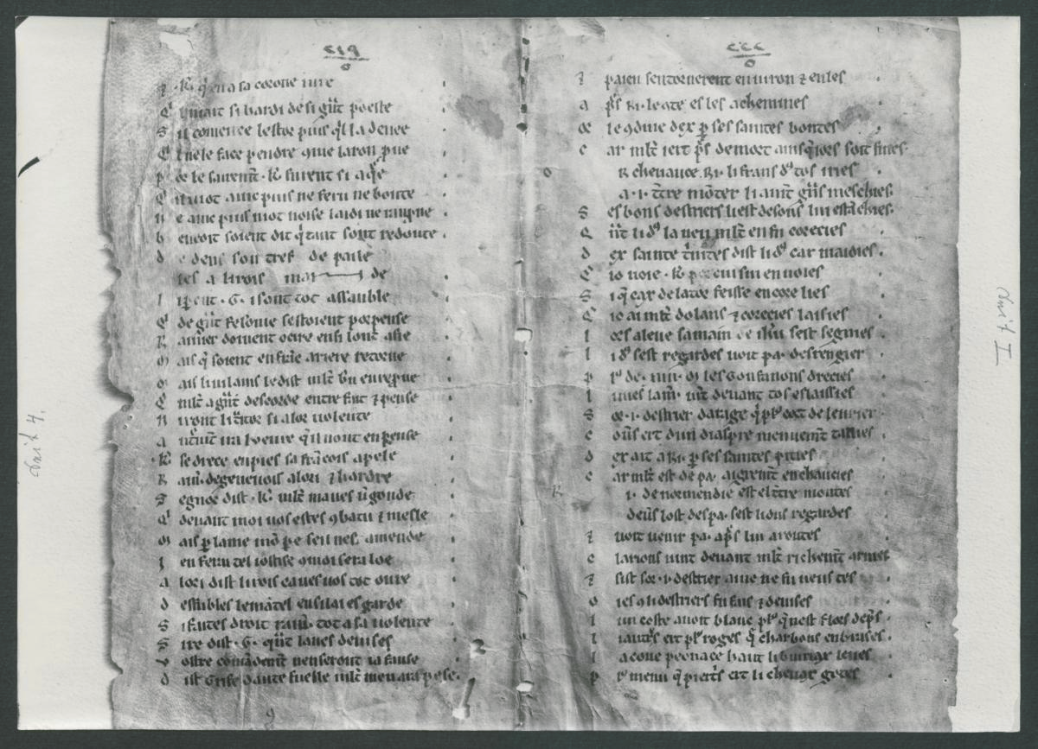
A fragment from the Fierabras; Qubbat al-Khazna, today: Berlin, Staatsbibliothek, simulata orientalia 6, fol. 51r.

Slide 5
Figures from the Account-Inventory
Jaque Vidaut – also referred to in the Kingdom’s sources as Iacobus Vitalis and Jacques Vidal. A French knight, holding a fief in the Kingdom, serving as marshal and renowned for his juridical expertise.
Estiene de Sissy – probably the same as Stephen of Cissey, the order’s marshal during 1261-2. Later in charge of the Templar province of Sicily-Apulia and a member of the delegation sent to escort Theobald Visconti, later Pope Gregory X, from Acre to the Papal court.
Salemon de Safforit and Lionnet de Tabarie – probably permanent residents of the Latin East.

Slide 6
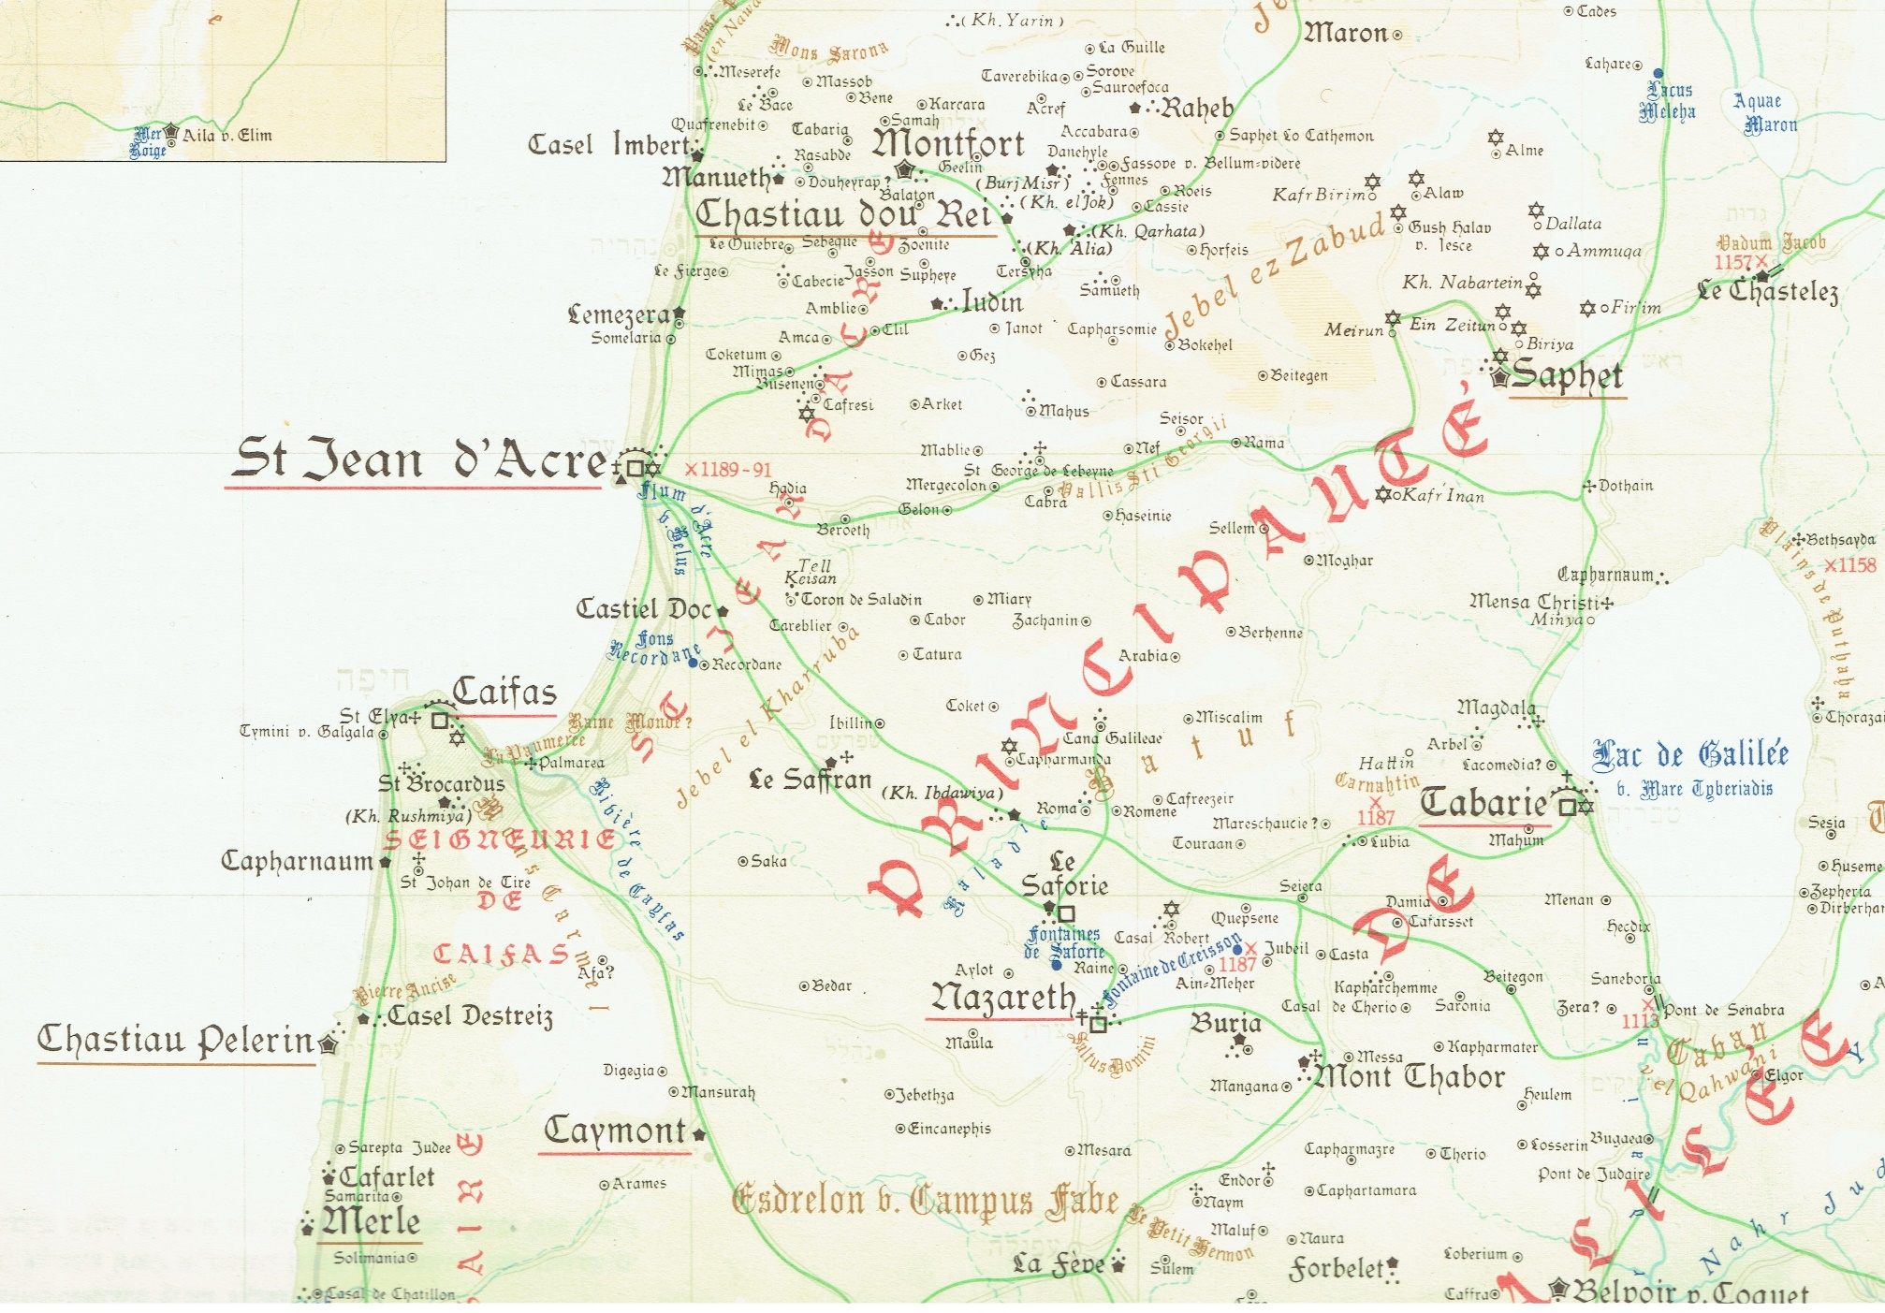
Prawer and Benvenisti, 1972

